Slide 1






S25' Training Sessions
mobile app
SESSION 4
#create_share_innovate

Slide 2




Table of contenet
S25' Training Sessions
Encapsulation
Inheritance
Inheritance

Slide 3



quiz
S25' Training Sessions
Which collection type in Dart maintains the insertion order of elements?
A) Set
B) Map
C) List

Slide 4
quiz
S25' Training Sessions
Answer: C) List
The List maintains the order in which elements are inserted, whereas a Set and Map do not guarantee order.

Slide 5
quiz
In Dart, how do you create a map with initial key-value pairs?
A) Map<String, int> map = {'A', 1, 'B', 2};
B) Map<String, int> map = {'A': 1, 'B': 2};
C) Map<String, int> map = {'A' -> 1, 'B' -> 2};
D) Map<String, int> map = ['A' => 1, 'B' => 2];
S25' Training Sessions

Slide 6
quiz
S25' Training Sessions
Answer:
B) Map<String, int> map = {'A': 1, 'B': 2};

Slide 7
quiz
What is the best way to define a constructor in Dart?
A) Car(String make, String model) { this.make = make; this.model = model; }
B) Car(this.make, this.model);
C) constructor Car(String make, String model) { this.make = make; this.model = model; }
D) Car({String make, String model}) { this.make = make; this.model = model; }
S25' Training Sessions

Slide 8
quiz
Answer:
B) Car(this.make, this.model);
S25' Training Sessions
A is True , but B is the best practice

Slide 9
quiz
What will happen if you try to add a duplicate value to a Set in Dart?
A) It will allow the duplicate value.
B) It will throw a runtime error.
C) It will ignore the duplicate value.
D) It will replace the existing value with the new one.
S25' Training Sessions

Slide 10
quiz
S25' Training Sessions
Answer:
C) It will ignore the duplicate value.

Slide 11
quiz
Which of the following statements about constructors in Dart is true?
A) A class can have only one constructor.
B) A constructor cannot have parameters.
C) A class can have multiple named constructors.
D) Constructors cannot be inherited.
S25' Training Sessions

Slide 12
quiz
S25' Training Sessions
Answer:
C) A class can have multiple named constructors.

Slide 13
Encapsulation
Encapsulation is the process of wrapping data (variables) and methods into a single unit (class).
It restricts direct access to data and allows controlled access through methods.
Advantages:
Protects object integrity.
Reduces complexity.
Facilitates code maintenance.
S25' Training Sessions

Slide 14
Encapsulation
Encapsulation is achieved using:
Private fields: Data members are marked as private using _.
Getters and Setters: Methods to access and modify private data.
S25' Training Sessions

Slide 15
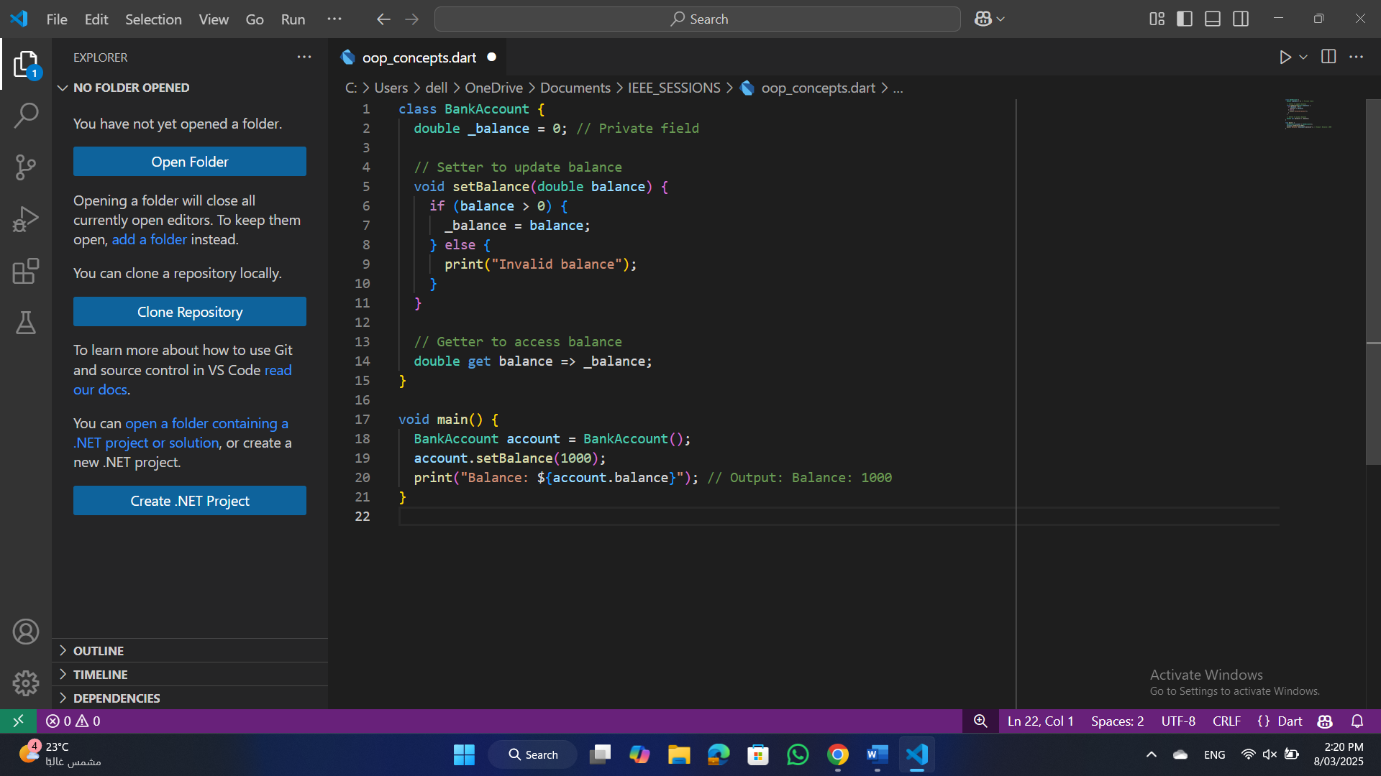
Encapsulation
Example:
Explanation:
_balance is private → Direct access is restricted.
setBalance() and get balance control how _balance is modified and accessed.
S25' Training Sessions

Slide 16
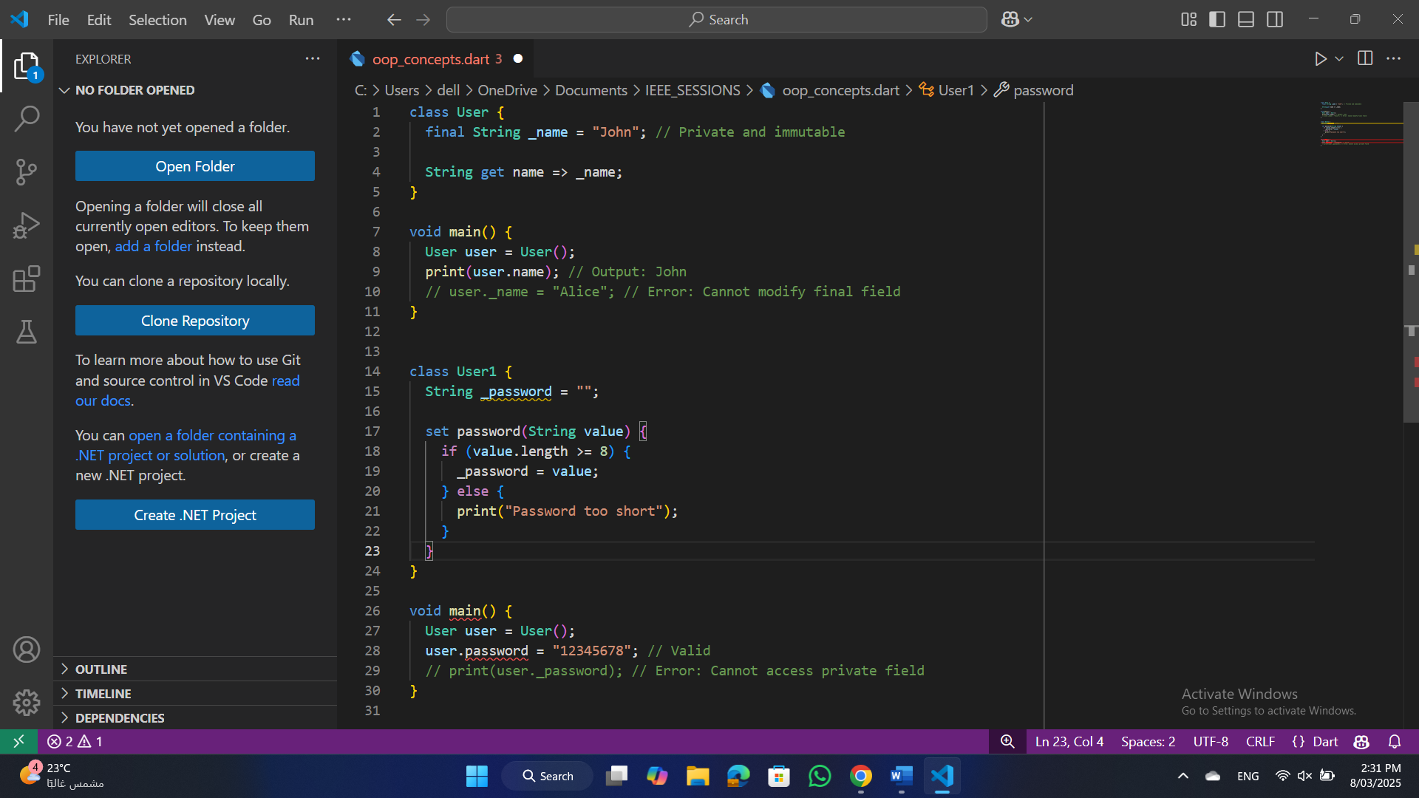
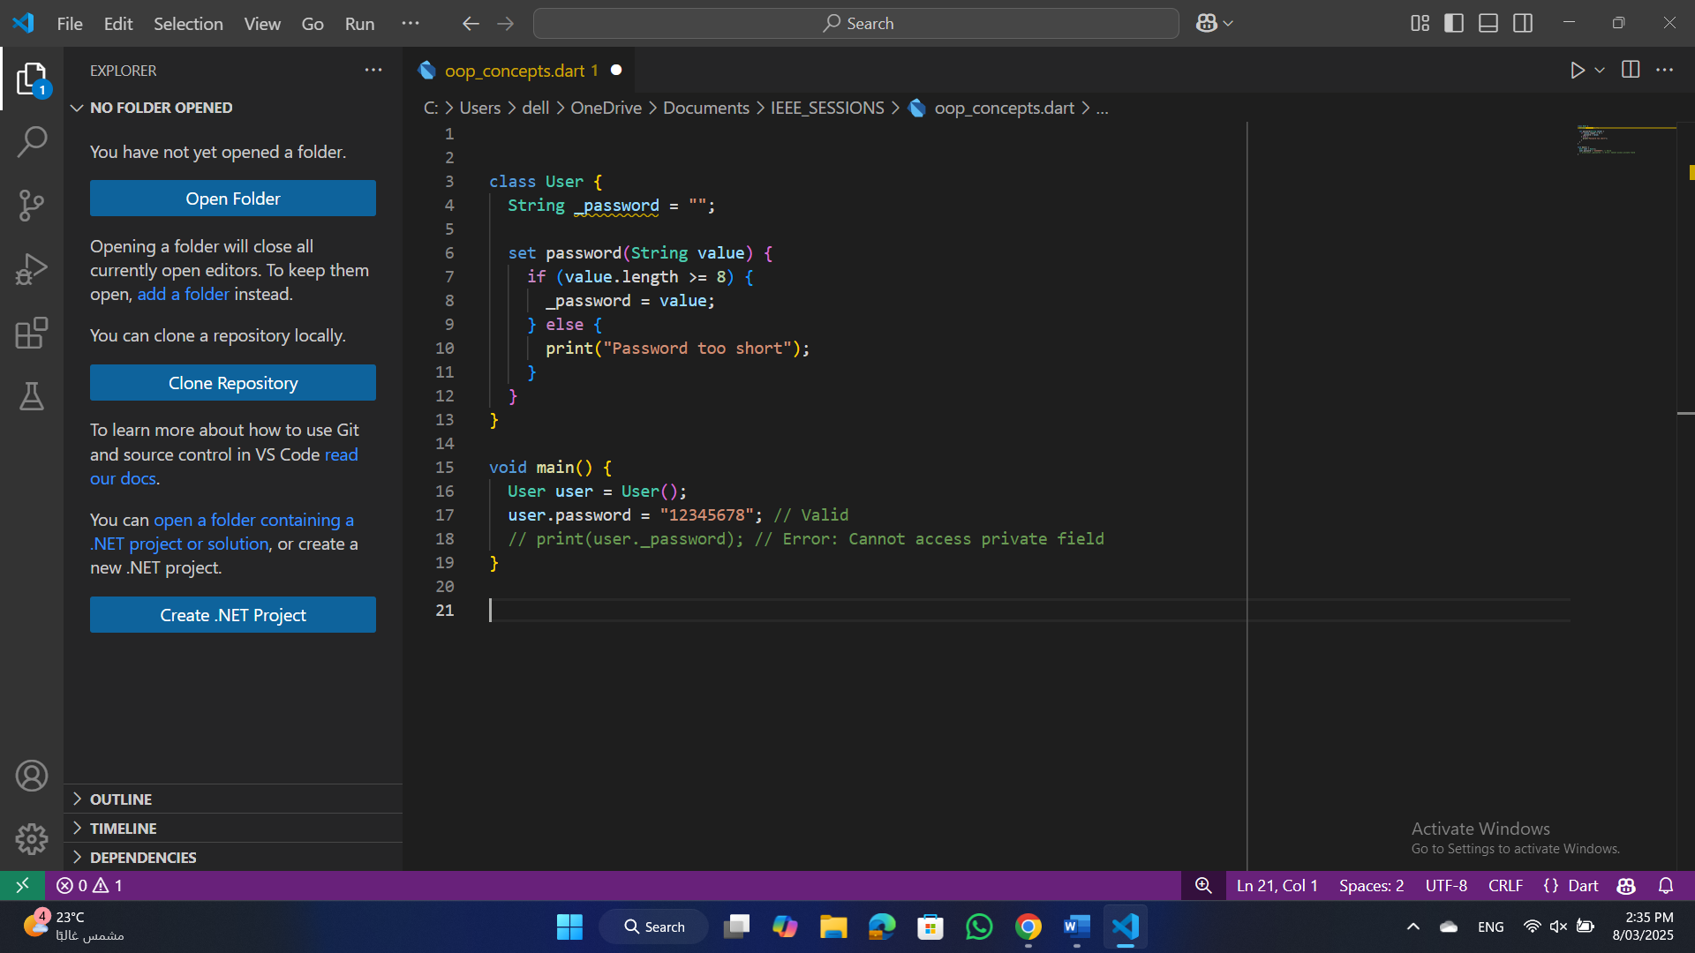
Encapsulation
Example 2:
(Read-Only and Write-Only Fields)
Read-Only Field:
Provide only a getter; no setter allows read-only access.
Write-Only Field:
Provide only a setter; no getter allows write-only access.
S25' Training Sessions

Slide 17
Encapsulation
Encapsulation (Best Practices):
Use private fields (_) to protect data from direct modification.
Use getters and setters to control data access and validation.
Avoid exposing internal state directly.
Ensure data consistency through validation inside setters.
S25' Training Sessions

Slide 18
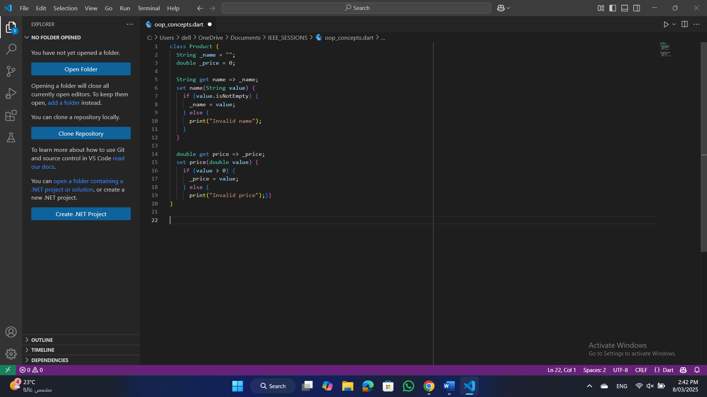
Encapsulation
Example:
Encapsulation ensures that the object's state remains valid and consistent.
S25' Training Sessions

Slide 19
Inheritance
Inheritance allows a class to inherit properties and methods from another class.
Establishes a parent-child relationship.
Using (extands) keyward
S25' Training Sessions
Why Use Inheritance?
Code Reusability: Write once, use multiple times.
Extensibility: New functionality can be added to existing classes without modifying them.
Polymorphism: Enables dynamic method binding.

Slide 20
Inheritance
Types of Inheritance:
Single Inheritance : One parent, one child.
Multilevel Inheritance : Child class inherits from parent, which also has a parent.
Hierarchical Inheritance : One parent, multiple child classes.
S25' Training Sessions

Slide 21
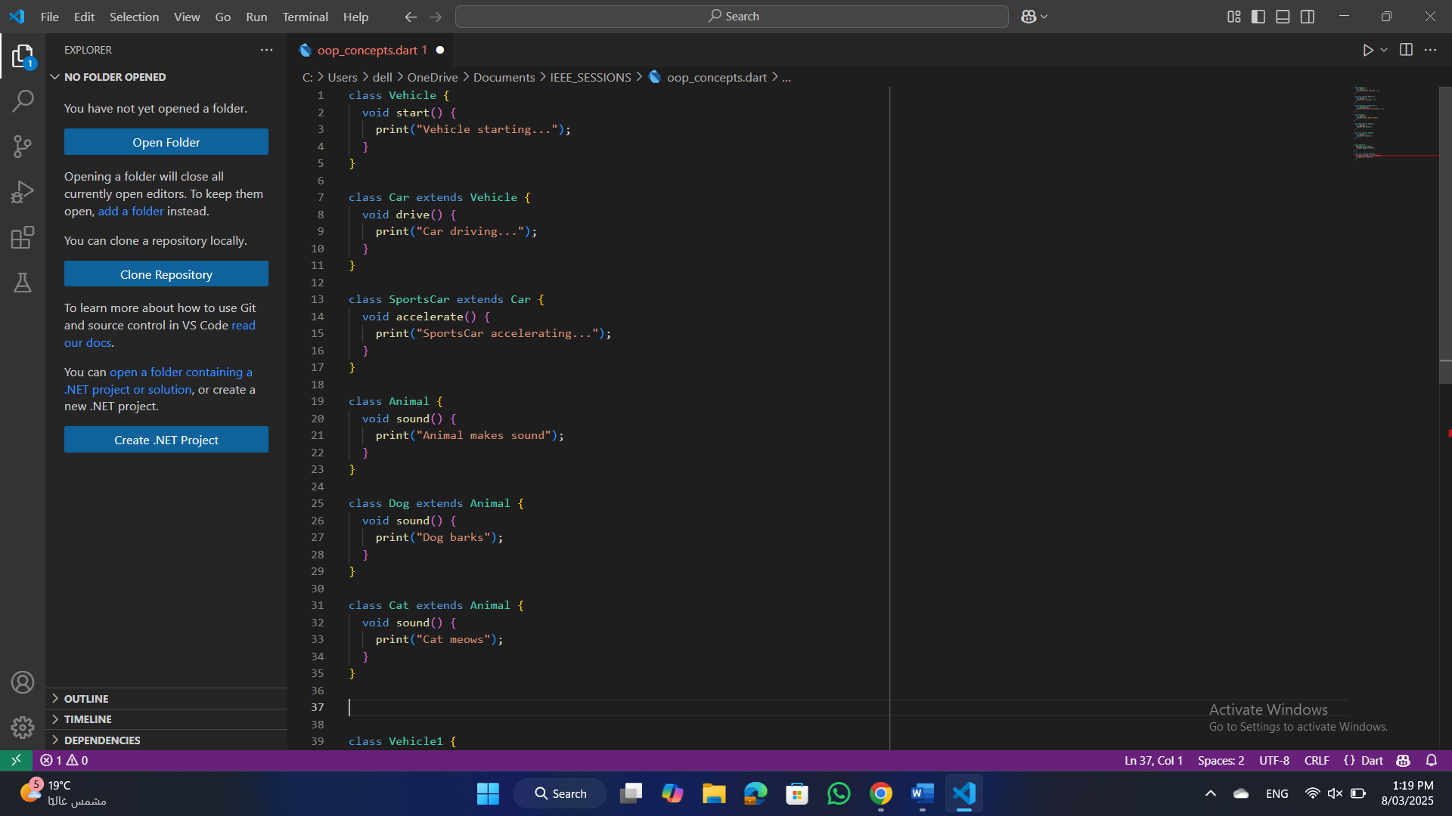
Inheritance
1. Single Inheritance
One parent class and one child class.
Child inherits properties and behaviors of the parent.
S25' Training Sessions

Slide 22
Inheritance
2. Multilevel Inheritance
A child class inherits from a parent class, and that parent class itself is a child of another class.
S25' Training Sessions

Slide 23
Inheritance
3. Hierarchical Inheritance
One parent class and multiple child classes.
Each child inherits properties and behaviors from the parent.
S25' Training Sessions

Slide 24
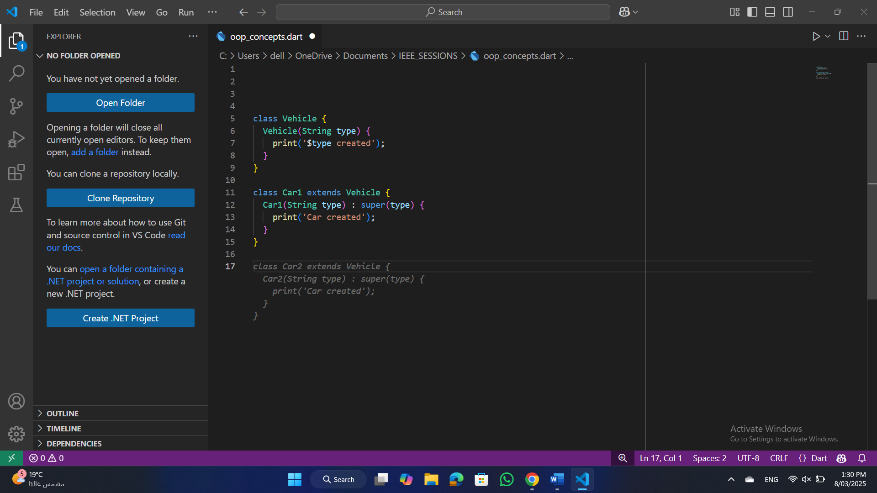
Inheritance
Constructor Chaining and (super) Keyword
super() calls the parent class constructor.
Used to initialize parent class attributes.
Rules:
super() must be the first statement in the constructor.
If a parent class has a parameterized constructor, it must be explicitly called.
S25' Training Sessions

Slide 25
Polymorphism
Ability to present the same interface for different forms (data types).
Behavior is determined at runtime or compile time.
Why Use Polymorphism?
Code Flexibility: Handle different objects uniformly.
Extensibility: Add new functionality with minimal code change
S25' Training Sessions
Types of Polymorphism:
Compile-Time Polymorphism (Static)
Run-Time Polymorphism (Dynamic)

Slide 26
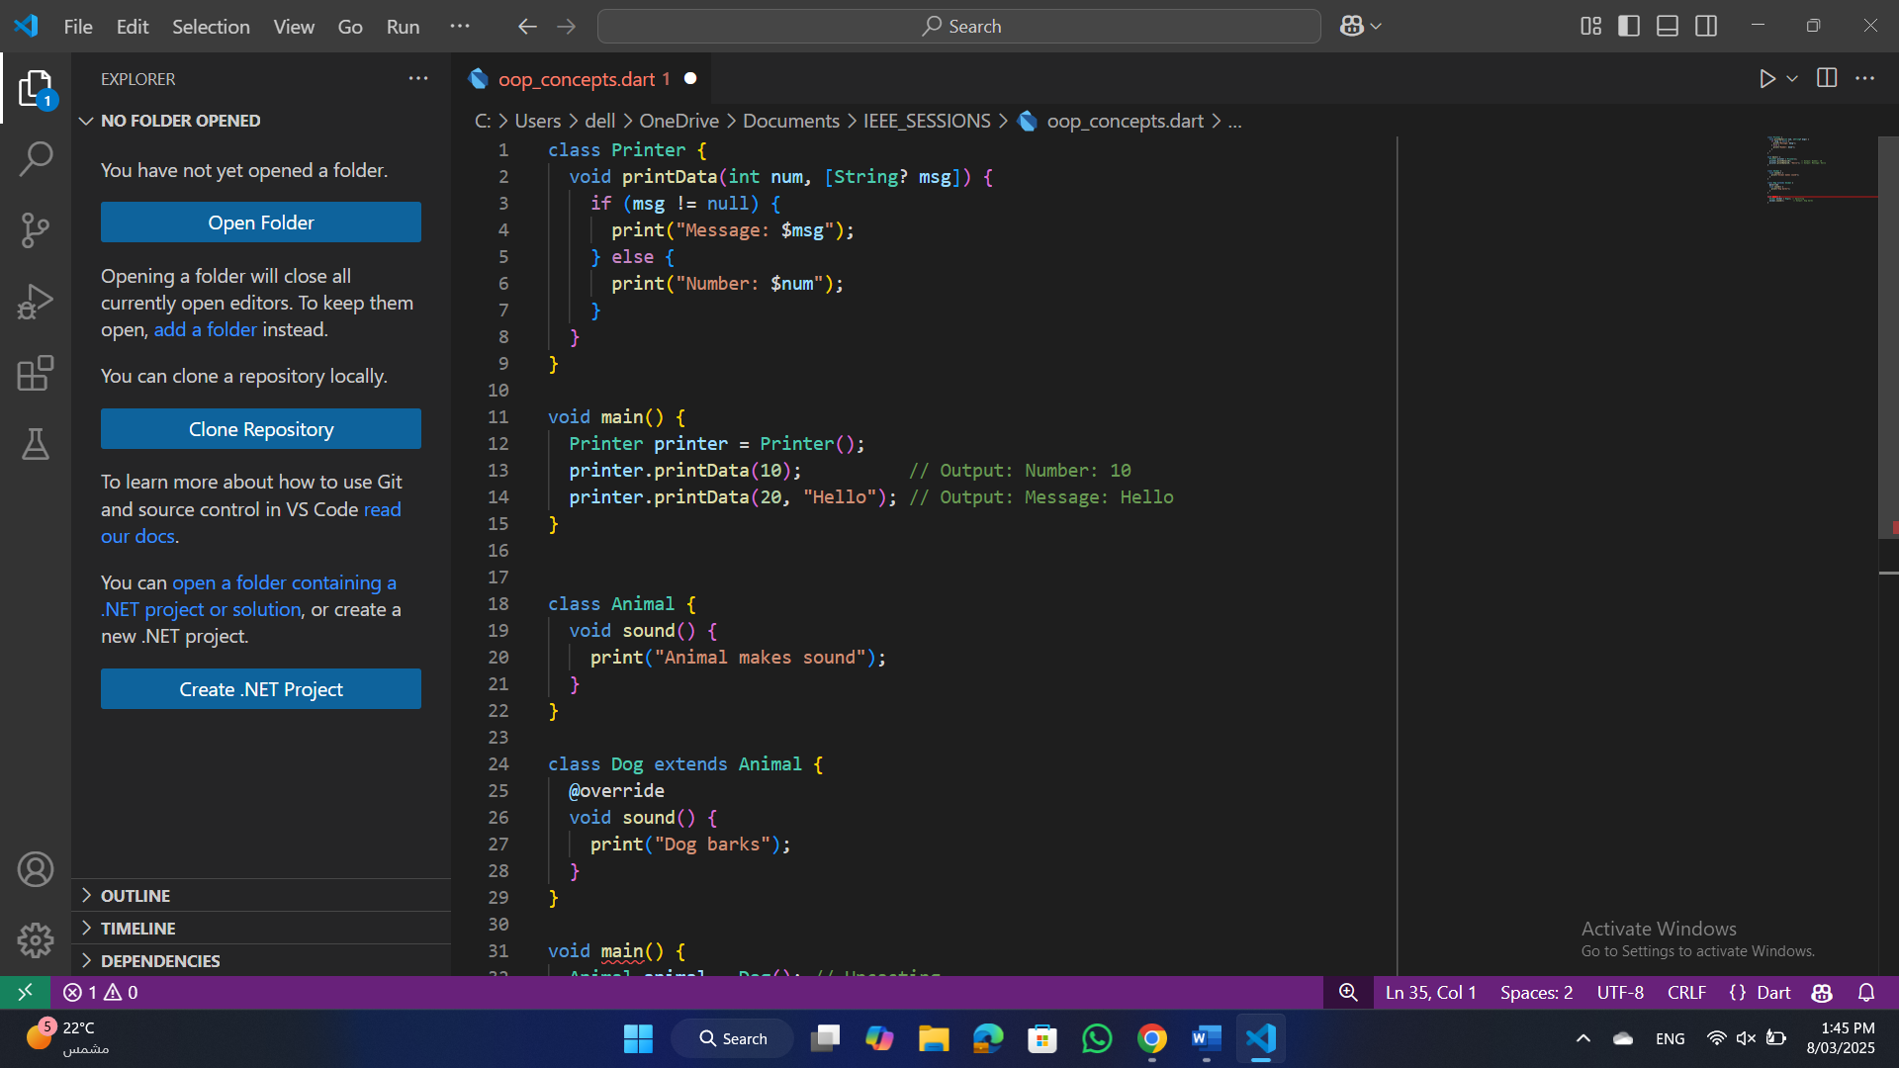
Polymorphism
Compile-Time Polymorphism (Static Binding)
Method binding is determined at compile time.
Achieved through method overloading and operator overloading
(not supported in Dart).
S25' Training Sessions

Slide 27
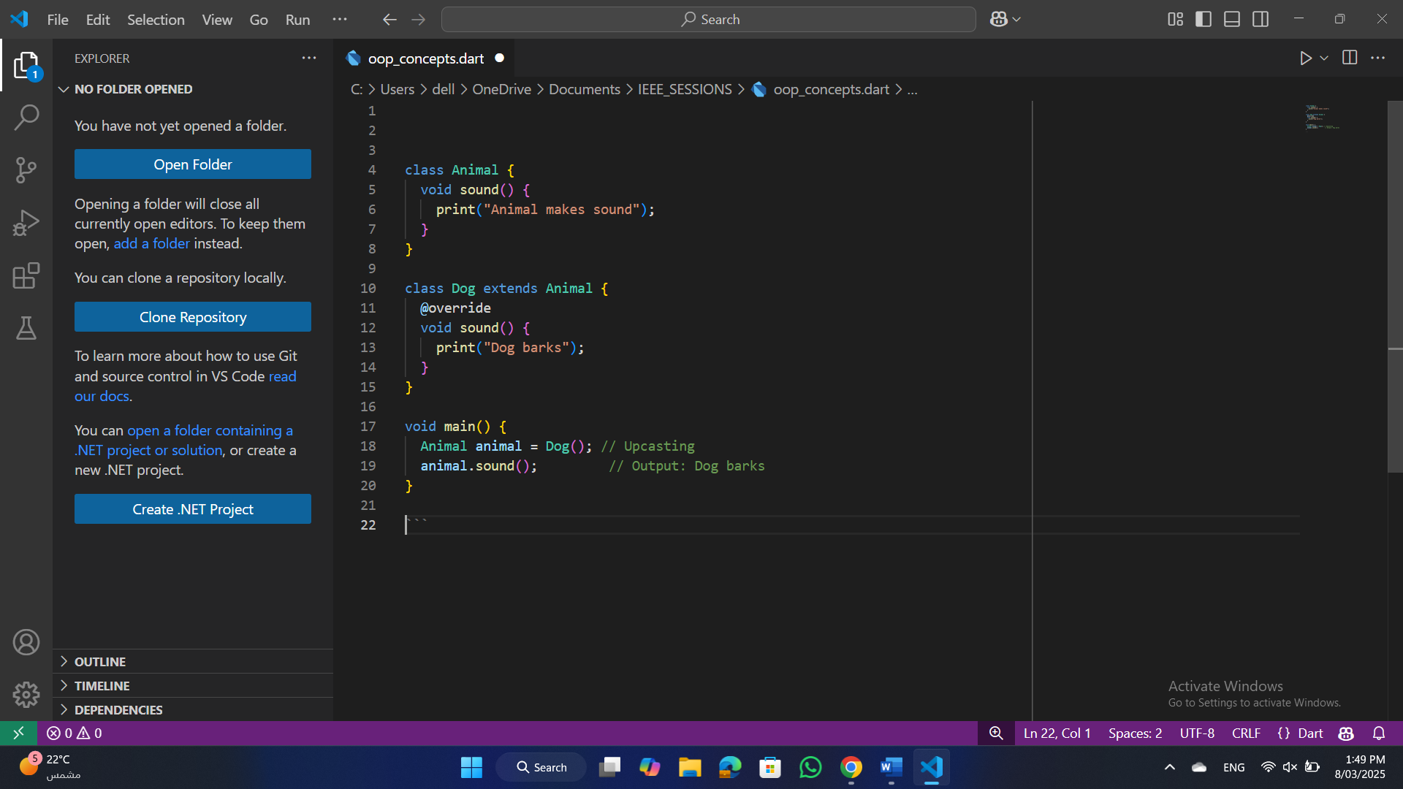
Polymorphism
Run-Time Polymorphism (Dynamic Binding)
Method binding is determined at runtime.
Achieved through method overriding.
S25' Training Sessions
Why Dynamic?
The method to be executed is determined at runtime based on the actual object type (Dog).

Slide 28
Exercise
Create a Shape class with a color and name property.
Make color private and use getters and setters to access it.
Create two classes Circle and Rectangle that inherit from Shape.
Circle should have a radius and a method to calculate its area.
Rectangle should have width and height and a method to calculate its area.
Add a displayDetails() method in Shape to print the shape's details.
Override this method in Circle and Rectangle to show their specific details.
Create a list of shapes and use a loop to display details of each shape.
S25' Training Sessions

Slide 29
task
S25' Training Sessions
Software solutions company system

Slide 30

tHANK YOU
SEE YOU NEXT TIME
S25' Training Sessions

